Slide 1
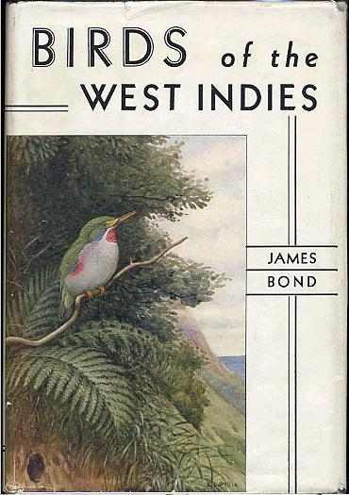
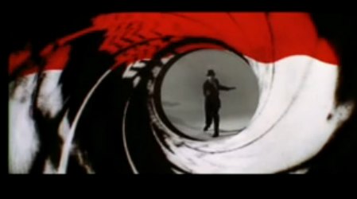
James Bond at 60
James Bond at 50 if dealing with only the movies
The Character was created by Ian Fleming in 1952
Supposedly named after a Philadelphia based ornithologist
The longest running film series in history starting in

